Slide 1
The Library
A Community Asset
in Disaster Preparedness, Response and Recovery

Slide 2


Presented by
Joshua L Taylor, Emergency Management Planner
Douglas County Emergency Management (DCEM)
Jessi Harris, Library Consultant & Information Resources Librarian
Northeast Kansas Library System (NEKLS)

Slide 3
How did this collaboration occur?
Community Emergency Response Team (CERT) training in Lawrence, KS
https://www.dgcoks.gov/emergency-management/cert-course-offerings
Libraries needed to update their plans ASAP!
Library Mini-CERT Pilot Program
Additional emergency concerns for libraries
  Print collections, servers, patron privacy
Notes:
Jessi:
Met with Kate Dinneen about possible training for librarians and how to create emergency plans.
Library Mini CERT program with the Baldwin City Library.
Discovered additional library concerns throughout the planning for the Mini CERT

Slide 4
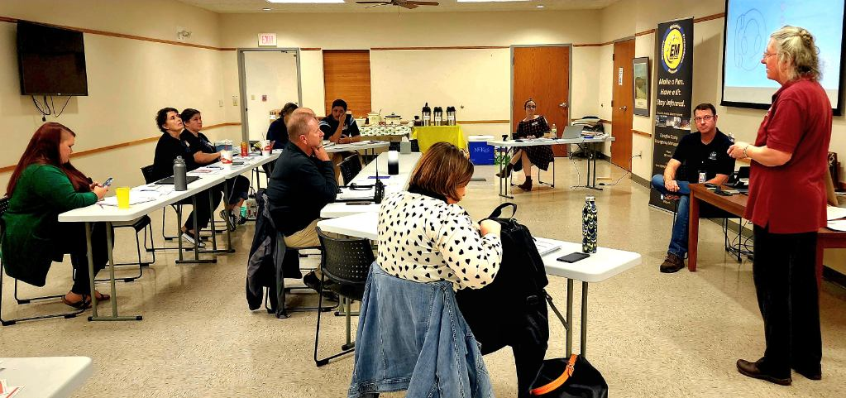
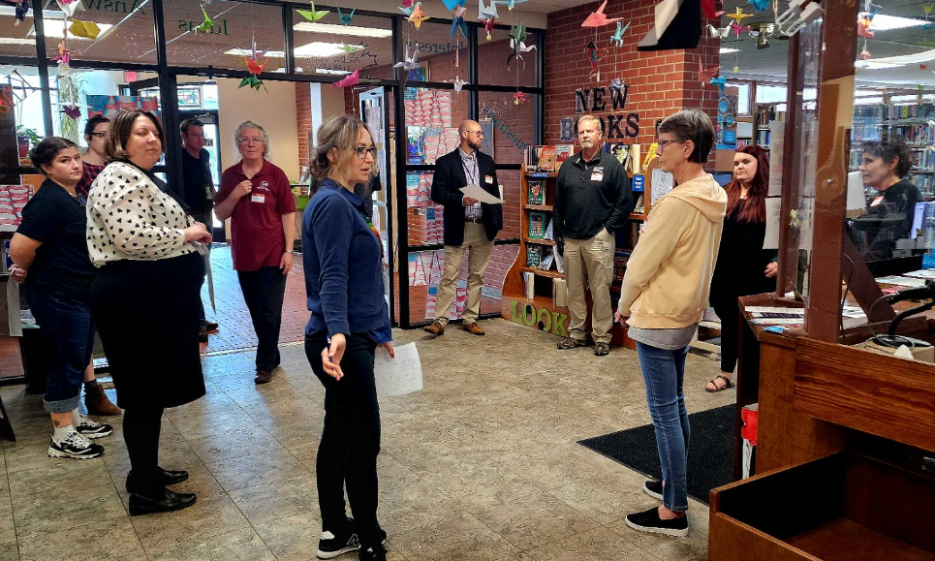
Pilot Program with the Baldwin City Library
Notes:
Library Mini-CERT pilot program created by DCEM and NEKLS.
We invited local service representatives from local service organizations. Police chief, school superintendent, city council member, FEMA rep, Boy Scout Leader.

Slide 5
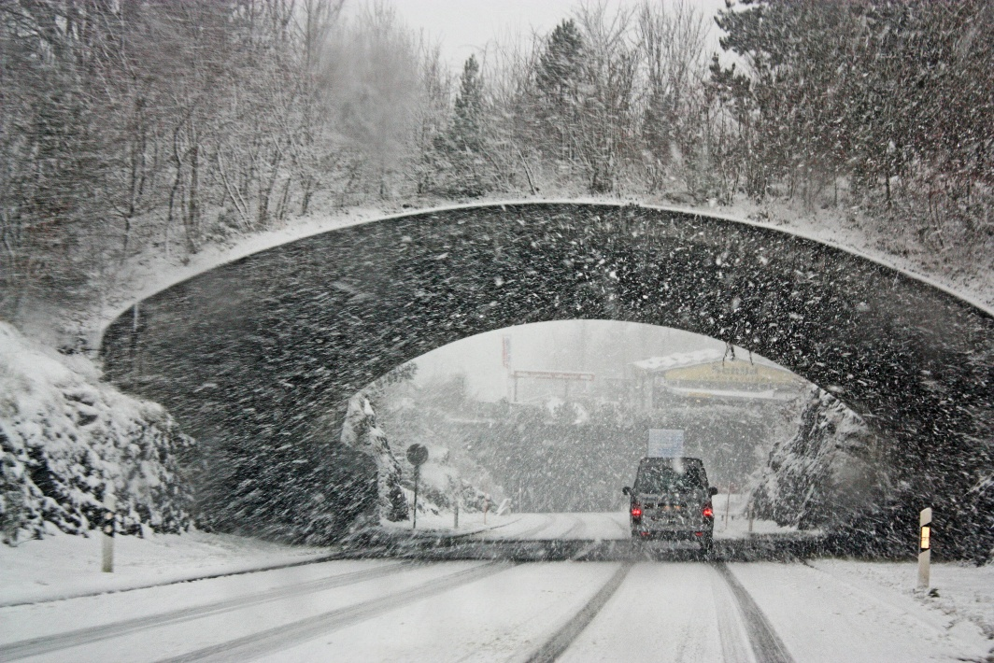
Lessons Learned in Baldwin
Community tornado shelter
Tornado plan for the library
Meeting room reservations during a blizzard
Notes:
The service organization representatives present discovered the assumed community shelter was under construction. Even if it was available, only one person had the key.
The library tornado plan to go to the hallway was a bad idea. It would turn into a wind tunnel. The bathrooms were the only option. Too small a space to hold the entire library. Not a shelter in an emergency.
The director did not bring home the meeting room reservations during a blizzard. Had to go to the library to check. No one was signed up. She could have saved herself a trip.

Slide 6
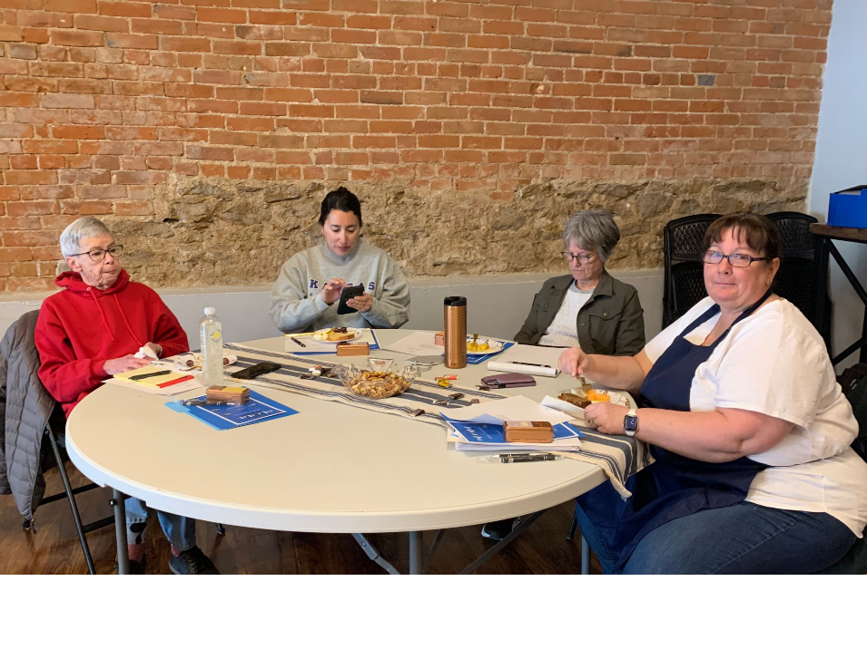
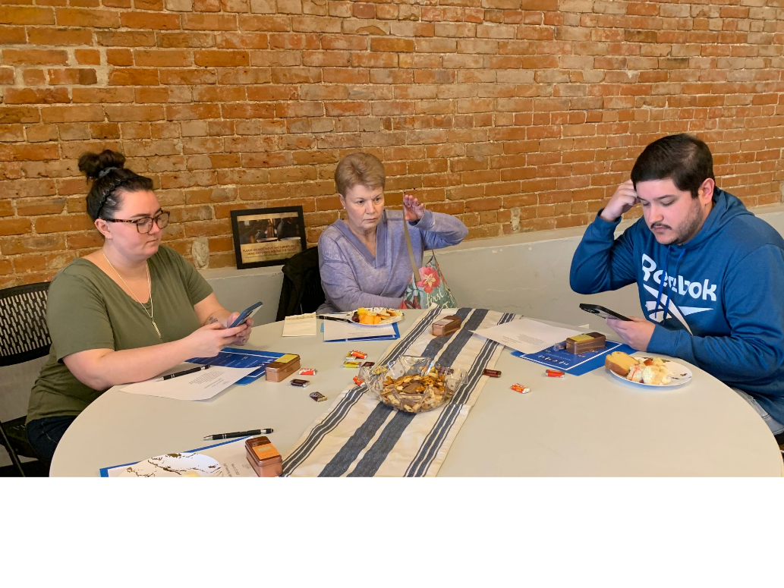
Eudora Community Library
Notes:
Hour long training with EAP and COOP template for Eudora at the community building.
We condensed the pilot program information for this training.

Slide 7
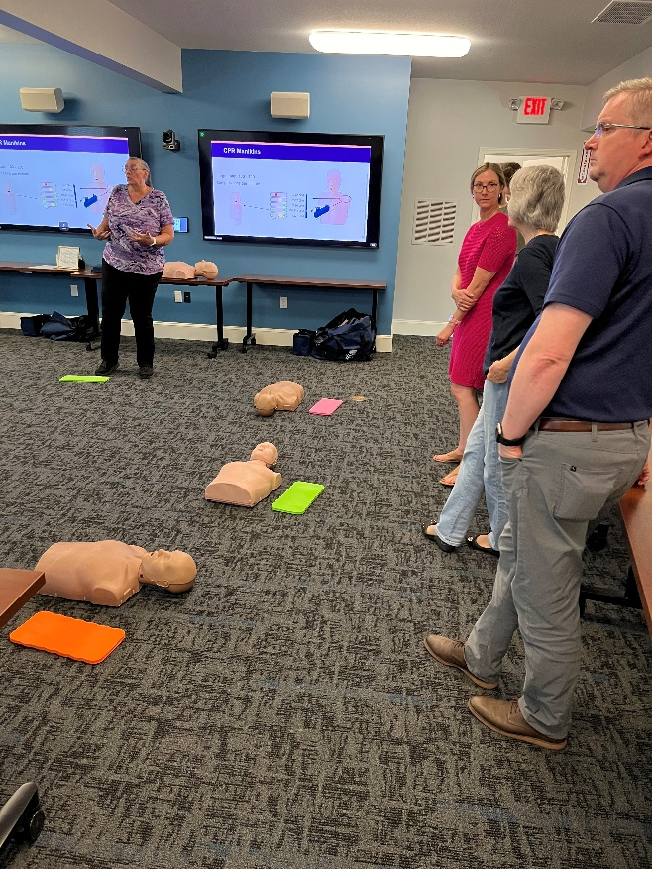
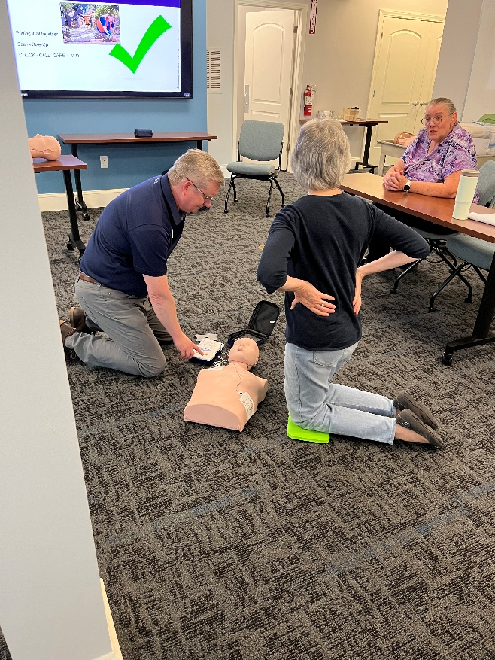
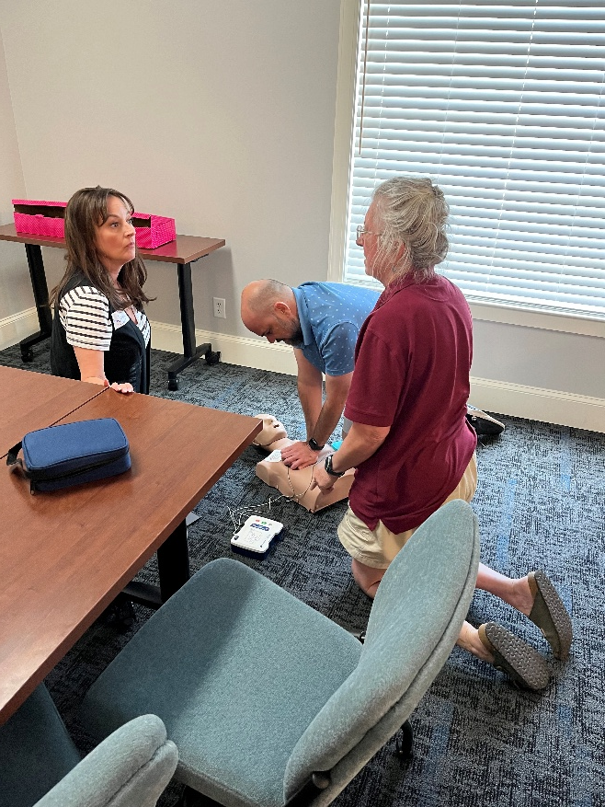
Northeast Kansas Library System (NEKLS)
Notes:
CPR and AED training for the NEKLS staff.
Local fire station provided the training with Kate from DCEM.
CPR is exhausting, but you can do it!
Transition: What do libraries already possess that makes them a community asset?

Slide 8
The Library as a Community Asset
Key Attributes of Libraries:
Safe Spaces: Welcoming environments for all community members.
Resource Hubs: Access to information, technology, and communication tools.
Community Connectors: Central locations fostering collaboration and support.
Notes:
“When disaster strikes, where does your community turn? Could your library be that place?”
Key Points:
Libraries are trusted, accessible hubs with unique assets (safe spaces, technology, staff expertise).
Highlight the slide’s descriptors (safe spaces, resource hubs, community connectors) and connect them to disaster scenarios (e.g., safe spaces for displaced families, tech for FEMA applications).
Reference the COOP template’s core mission to underscore libraries’ role in community resilience.
Libraries are more than repositories; they can be vital community hubs during times of crisis. What unique qualities does your library offer that can support your community during a disaster?
Transition: “Let’s discuss more about how libraries can be a community’s safe space.

Slide 9

*Libraries as Safe Spaces
Libraries are considered a public space
Photography and filming
Police and ICE
Notes:
Jessi: Anyone can take photos and film in a public space. *The library should still try to obtain permission for photos of patrons if possible!
Remember that police and ICE can enter the library at any time. It is a public building.
Build a relationship with your local police department before you may need them. Discuss possible scenarios when they may be called and the needs of the library. This will hopefully eliminate any confusion, or frustration between your organizations.
Transition: “Let’s explore why these attributes make libraries indispensable during crises.”

Slide 10
Why Libraries Matter in Disasters
Libraries are uniquely positioned to support communities during crises due to their:
Accessibility: Open to diverse groups, including underserved populations.
Infrastructure: Equipped with meeting spaces, computers, and internet access.
Trusted Role: Recognized as reliable, nonpartisan community centers.
Notes:
Libraries’ unique position as a nonpartisan, accessible space. That has the potential to fill roles within your community that may otherwise not be available.
NOTE: the MOU/MOA template section.
Key Points:
Libraries’ accessibility reaches underserved groups, critical during disasters when gaps in service can widen.
Infrastructure (computers, Wi-Fi, meeting rooms) supports practical needs like communication and coordination.
Trusted status makes libraries natural hubs for recovery efforts (e.g., distributing aid information).
A real-world case (e.g., Houston Public Library post-Hurricane Harvey provided Wi-Fi and FEMA application support).
How do your library’s attributes (e.g., safe space, central location) possibly enhance its capability or role during community stress or disaster?
Transition: “To maximize this role, we need to understand who relies on our libraries and how they use them.”

Slide 11
Understanding Your Community
Demographics: Age groups (children, teens, seniors), local clubs, or organizations.
Usage Patterns:
Meeting spaces for groups.
Computer and internet access for job searches or emergency resources.
Safe spaces for youth, seniors, or displaced individuals.
Educational programs (e.g., storytime, workshops).
Notes:
Who Are Your Users?
Key Points:
Map patron demographics (e.g., seniors, youth, local clubs) to tailor disaster services (e.g., childcare for working parents).
Highlight usage patterns: meeting spaces for community groups, computers for jobless individuals, or safe spaces for teens.
Reference the EPRP’s emphasis on staff awareness to ensure services match community needs.
Jessi: Libraries should be doing this already to provide services and programming to their communities. Simply apply that information to EM functions.
“Who are your key patrons, and how might their needs change in a crisis? Map out your patron base and their needs during a crisis to tailor services effectively.
Maybe create a local patron profile checklist (e.g., age groups, needs, usage) to guide planning.
Transition: “Now that we know our users, let’s identify the assets we can leverage.”

Slide 12
Leveraging Library Assets
Facility Assets for Disaster Support:
Physical Space: Meeting rooms, children’s areas, or quiet zones for recovery activities.
Technology: Public computers, Wi-Fi, and charging stations for emergency communications.
Programs: Existing programs like Storytime or senior workshops can be adapted for crisis support.
Location: Central or accessible sites for community gathering.
Notes:
Create a list of your library’s assets (e.g., space, tech, staff expertise) that could be mobilized during a disaster.
Key Points:
Physical spaces (e.g., meeting rooms) can serve as volunteer centers or shelters.
Technology (computers, Wi-Fi) supports critical tasks like filing insurance claims.
Programs like Storytime can expand to provide childcare, freeing parents for recovery tasks.
Central locations make libraries accessible hubs for aid distribution.
Another library that utilized its children’s section as a daycare after the disaster.
Transition: “These assets are powerful, but partnerships amplify their impact.”

Slide 13
Building Community Partnerships
Potential Partners:
Traditional: Fire department, police, schools, public health, local government.
Non-Traditional: Local businesses (restaurants, cafes), scout troops, community service groups (Lions Club, Rotary).
Key Individuals: Emergency managers, community leaders, or local volunteers.
Notes:
Develop a contact list of partners (aligned with the COOP template’s External Support Team table) to foster collaboration. It is important to collaborate, aligning this with the MOU/MOA’s roles and responsibilities.
Key Points:
Traditional partners (fire, police, schools) provide expertise and resources.
Non-traditional partners (restaurants, scout troops) offer unique support (e.g., food donations, volunteer labor).
Reference the COOP’s External Support Team table for creating a contact list.
Some success stories have been a library partnering with a local café to provide meals during a power outage.
“Who’s one non-traditional partner in your community you could approach? Feel free to write it down.” Use the COOP’s contact table template to begin building a partner list after the conference.
Transition: “Let’s see how daily operations can become disaster assets.”

Slide 14
Day-to-Day Operations as Disaster Assets
Current Functions with Disaster Potential:
Regular Programs: Storytime can expand to provide childcare during recovery, freeing parents to access resources.
Technology Access: Computers for filing FEMA claims or connecting with support services.
Staff Expertise: Librarians trained in information navigation can assist with resource searches.
Notes:
Expand children’s Storytime to include extended hours, collaborating with childcare providers to support displaced families. Connect routine functions to disaster response, aligning with the COOP’s essential functions and EPRP’s recovery focus.
Key Points:
Storytime can expand to support displaced children, as shown in the original presentation.
Computer access aids in accessing relief resources (e.g., FEMA forms).
Only those staff who have received “Just-In-Time” training from EM or FEMA can help patrons fill out FEMA forms. Similar process and rules as with tax forms.
Librarians’ information navigation skills are critical for guiding patrons to aid.
In another area, a library’s Wi-Fi supported job applications during a post-disaster economic recovery and was a resource center. “What’s one daily program in your library that could be adapted for disaster response? Share with the group.”
Transition: “But more on childcare.”

Slide 15
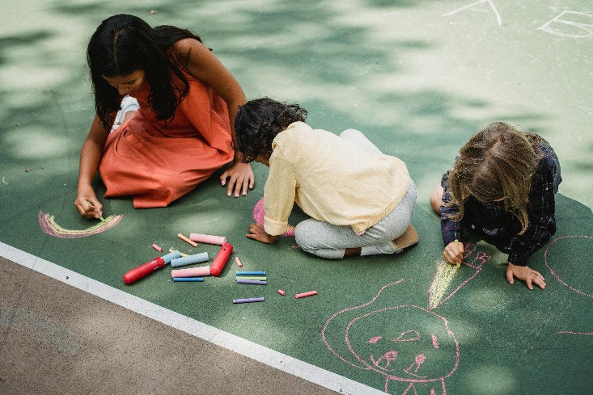

Childcare Policy
Libraries do not act in loco parentis.
The same unattended child policies apply during and after a disaster.
Consider posting policies in an emergency for clarity.
If contracting with a local daycare, have the responsibilities clearly stated for parents and staff.
Notes:
Jessi:
Childcare
Libraries do not act in loco parentis.
The same unattended child policies apply.
The age at which children can be at the library unattended. Different for each library
Consider posting policies in an emergency for clarity.
Transition: “When disaster strikes, how do we activate these assets?”

Slide 16
Activating the Library in a Disaster
Immediate Steps Post-Disaster:
Ensure Safety: Follow COOP and EPRP protocols to secure the facility and staff.
Assess Resources: Activate spaces, technology, and staff for community support.
Communicate: Use social media, websites, and partner networks to share available services (per EPRP Communications Equipment/Systems).
Notes:
Coordinate with partners to align library services with community needs. Outline immediate response steps, aligning with the EPRP’s emergency procedures and COOP’s continuity communications.
Key Points:
Prioritize safety using EPRP protocols (e.g., evacuation plans, utility checks).
Activate resources such as computers and meeting rooms to support the community.
Communicate via social media and partner networks (per EPRP’s Communications Equipment/Systems).
“What’s one communication channel your library could use in a crisis?” Ensure a hard-copy contact list (per COOP) for offline communication.
Transition: “Activation requires practical planning, let’s explore how.”

Slide 17
Practical Planning for Disaster Response
Adapt Day-to-Day Protocols:
Hours of Operation: Extend or modify hours to accommodate recovery needs.
Staffing: Train staff for emergency roles (per COOP Incident Management Team).
Utilities: Ensure backup power or water management plans (aligned with EPRP Utilities section).
Notes:
Engage partners to address logistical challenges (e.g., resource allocation, volunteer coordination). Adapt daily protocols for crises, aligning with the EPRP’s utilities and COOP’s staffing plans.
Key Points:
Adjust hours to meet recovery needs (e.g., extended evening access).
Train staff for emergency roles (per COOP’s Incident Management Team).
Plan for utilities (e.g., backup generators) using EPRP’s utility guidelines.
“What’s one operational change your library could make for disaster response? Jot it down.” Maybe revise library protocols to include disaster-specific adjustments.
Transition: “Let’s clarify work and volunteer hours.”

Slide 18
Work Hours vs. Volunteer Hours
Library staff cannot volunteer for the library. It is illegal.
  Make your policies clear.
  Example policy.
  It needs to be clear that there is no expectation for staff to take on volunteer work.
How will the hours be extended during/after a disaster?
Hourly workers need to be paid for overtime.
Have your library board volunteer to staff the desk.
  Board members cannot be paid to work for the library.
Notes:
Jessi:
Hours of operation
Library staff cannot volunteer for the library. They need to be paid when working for the library.
Make policies clear.
Example policy below.
How will the hours be extended?
Hourly workers need to be paid for overtime.
Have your library board volunteer to staff the desk? They cannot be paid for this volunteer time.
Transition: “Let’s start building your plan with these first steps.”

Slide 19
First Steps in Planning
Brainstorm Assets: Identify library resources and nearby community assets.
Create Contact Lists: Use the COOP template’s Emergency Contacts and External Support Team tables.
Develop an Outline: Draft a plan for how the library can support preparedness, response, and recovery.
Engage Stakeholders: Host a meeting with community leaders to gather input and refine the plan.
Notes:
Provide a clear starting point, aligning with the COOP’s incident management and MOU/MOA’s purpose. Then use the MOU/MOA templates to formalize partnerships.
Key Points:
Brainstorm assets and nearby resources (e.g., community centers).
Create contact lists using the COOP’s Emergency Contacts table.
Draft an outline and engage stakeholders for feedback.
Reference MOU/MOA templates for formalizing partnerships.
Transition: “But what are some Unique considerations for your Community?”

Slide 20
Unique To Your Community
Police station, fire station, and library are all located beside train tracks.
  How would the community handle a derailment at that location?
The library is in a flood plane.
Your neighborhood has a factory that contains hazardous chemicals.
Children have to cross a highway to reach your library from the school.
Notes:
Jessi:
Silver Lake
Delaware Township Library Valley Falls
Meriden-Ozawkie
Transition: “Next, involve first responders to refine your plan.”

Slide 21
Engaging First Responders and Leaders
Second Steps:
Invite first responders, emergency managers, and local officials to review the plan.
Align with local emergency management protocols (e.g., Local Emergency Operations Plan/FEMA’s ready.gov resources).
Incorporate feedback to ensure the library’s role complements community-wide efforts.
Notes:
This step builds trust and ensures the library is integrated into broader emergency plans.
Key Points:
Invite fire, police, and emergency managers to review the plan.
Align with FEMA’s Ready.gov resources for credibility.
Feedback ensures the library complements community efforts.
“Who’s one first responder you could invite to your planning meeting?”
Transition: “Now, let’s expand your partner network.”

Slide 22
Expanding Partnerships
Third Steps:
Reach out to additional partners identified in initial meetings (e.g., schools, scout groups, or local businesses).
Explore volunteer support for tasks like distributing preparedness materials or staffing recovery programs.
Use the MOU/MOA templates to formalize agreements with new partners.
Notes:
Create a draft plan incorporating stakeholder feedback and share it with potential partners.
Key Points:
Engage new partners (e.g., schools, scouts) identified in initial meetings.
Leverage volunteers for tasks like distributing supplies.
Use MOU/MOA templates to formalize agreements.
“What’s one volunteer group you could involve in your plan?”
Transition: “With partners on board, let’s finalize and test the plan.”

Slide 23
Finalizing and Testing the Plan
Refine
Refine the Plan: Tailor it to your community’s specific needs and risks.
Test
Test Annually: Conduct drills (per COOP Tests, Training, and Exercises section) and make it a community event.
Share
Share Resources: Distribute preparedness materials (e.g., FEMA handouts, local emergency management guides) in the library.
Notes:
Ensure the plan is actionable and community-specific, aligning with the COOP’s Tests, Training, and Exercises and EPRP’s plan maintenance.
Host an annual “Disaster Preparedness Day” with local experts and interactive activities.
Key Points:
Tailor the plan to local risks (e.g., floods, earthquakes).
Conduct annual drills, making them community events (e.g., “Disaster Preparedness Day”).
Distribute FEMA materials to raise awareness.
“What’s one fun way to make disaster drills engaging in your community?” Use the COOP’s Test, Training, and Exercise Log to document lessons learned.
Transition: “Resources can help you build this plan, let’s explore them.”

Slide 24
Resources for Implementation
Reimagine Libraries: Explore Mega Subramaniam’s framework for community-focused disaster planning (https://reimaginelibraries.ischool.umd.edu/).
Local Emergency Management: Collaborate for risk assessments and best practices.
FEMA’s Ready.gov: Downloadable preparedness materials for community distribution.
Other Libraries: Share resources and strategies with nearby libraries for mutual support.
The Disaster Planning Handbook for Libraries: by Mary Grace Flaherty with Katherine R. Greene and Michelle Runyon
Notes:
Compile a resource list tailored to your community’s needs.
Key Points:
Reimagine Libraries (https://reimaginelibraries.ischool.umd.edu/) offers adaptable strategies from COVID-19 response.
Local emergency management can provide risk assessments and training.
FEMA’s Ready.gov offers free materials for community outreach.
Networking with other libraries fosters mutual aid.
“What’s one resource you’ll explore after this training / post-conference?”
Transition: “Formal agreements solidify your role, let’s discuss MOUs and MOAs.”

Slide 25
Formalizing the Role with MOUs/MOAs
Why Formal Agreements?
Clarify roles and responsibilities (e.g., library as a Resource Center or Volunteer Reception Center).
Ensure mutual support with partners (e.g., training from local government, space from the library).
Align with MOU/MOA templates to define activation protocols, funding, and confidentiality.
Notes:
Draft an MOU or MOA (legally binding) with key partners using the provided templates.
Key Points:
MOUs/MOAs clarify roles (e.g., Resource Center, Volunteer Reception Center).
Define mutual support (e.g., training from partners, space from libraries).
Ensure activation protocols and confidentiality (per MOU/MOA templates).
Some libraries have signed an MOU with their fire department to serve as a cooling center.
“What’s one role your library could formalize with an MOU?”
Transition: “Let’s wrap up with a call to action.”

Slide 26
EPRP, COOP, and MOU Templates
Library Emergency Preparedness, Response, and Recovery Plan (EPRP)
Continuity of Operations Plan (COOP)
Memorandum of Understanding (MOU)
https://systems.mykansaslibrary.org/emergency-action-planning/
Notes:
Jessi / Joshua

Slide 27
Call to Action
Your Library’s Role in Resilience:
Leverage existing assets to support your community in crises.
Build partnerships to enhance preparedness and recovery efforts.
Formalize plans with COOP and EPRP frameworks to ensure readiness.
Next Steps:
Schedule a staff brainstorming session to identify assets and partners.
Draft a preliminary plan and share it with community stakeholders.
Test and refine the plan annually to keep it relevant.
Notes:
Jessi:
Key Points:
Libraries are cornerstones of resilience with unique assets and partnerships.
Start with a staff brainstorming session, draft a plan, and test it annually.
“Your library can save lives and rebuild communities.”
“What’s one step you’ll take within 30 days to start this process?”
Q&A: Open the floor for questions, encouraging attendees to share their library’s context or challenges
Joshua:
Closing: “Together, we can make libraries the heart of community resilience for your community. Let’s start today!”

Slide 28
Contact Information
Joshua Taylor, Emergency Management Planner
  Douglas County Emergency Management (DCEM)
  jtaylor@dgcoks.gov
  https://www.dgcoks.gov/emergency-management
Jessi Harris, Library Consultant & Information Resources Librarian
  Northeast Kansas Library System (NEKLS)
  jharris@nekls.org
  https://www.nekls.org/

